Slide 1

CYBER SECURITY AWARENESS PROGRAMME
By: YUSUF

Slide 2
AGENDA
WHAT IS CYBER SECURITY?
NEED FOR CYBER SECURITY AWARENESS
OVERVIEW OF EMERGING CYBER THREATS
GENERAL SECURITY BEST PRACTICES
HOW TO SECURE HOME WIRELESS NETWORK

Slide 3
WHAT IS CYBER SECURITY?
Cyber security is the practice of defending computers, servers, mobile devices, electronic systems, networks, and data from malicious attacks. It's also known as information technology security or electronic information security.

Slide 4
CYBER SECURITY AWARENESS PROGRAMME
The awareness programme helps understands users about IT governance & recognize security concerns and their relevance, so as to respond timely with corrective actions.

Slide 5
OVERVIEW OF EMERGING CYBER THREATS
Phishing
Vishing
SMSishing
Virus / Malwares
Mobile Malwares
Ransomware
Banking Frauds
ATM Skimming
OTP Theft
Social Media Threats

Slide 6
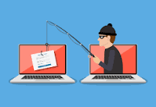
PHISHING
Phishing is the fraudulent attempt to obtain sensitive information such as usernames, passwords and credit card details by disguising oneself as a trustworthy entity in an electronic communication. Typically carried out by email spoofing or instant messaging it often directs users to enter personal information at a fake website which matches the look and feel of the legitimate site.

Slide 7
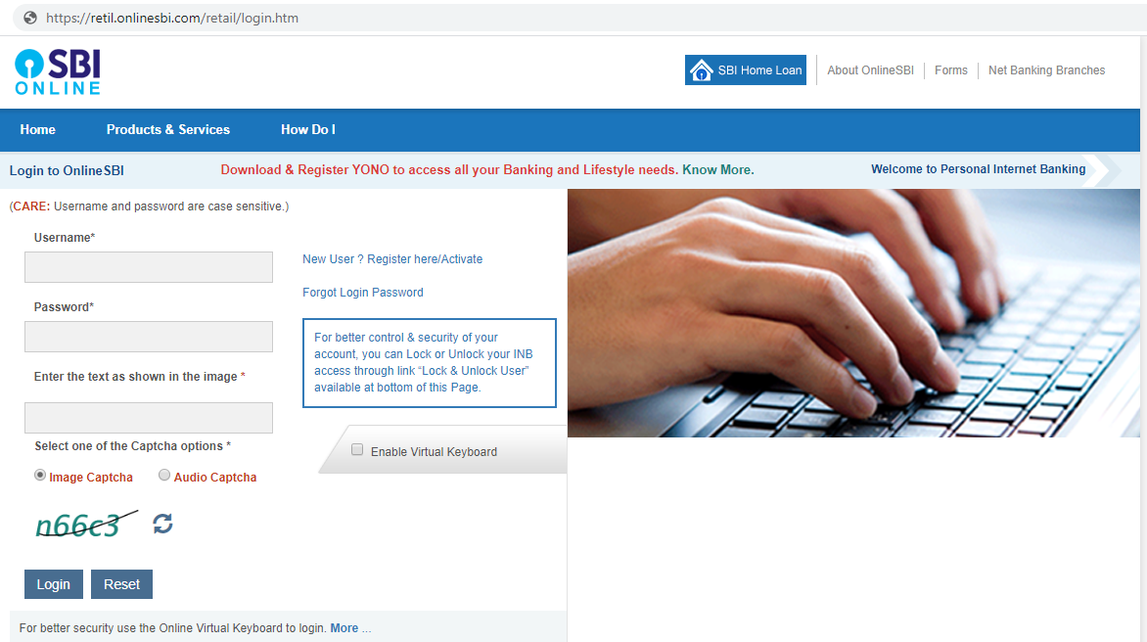
PHISHING EXAMPLE

Slide 8
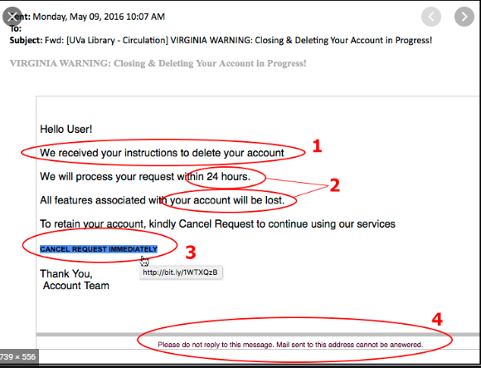
PHISHING EXAMPLE

Slide 9

PHISHING PREVENTION
Keep Informed About Phishing Techniques
Think Before You Click!
Type URL’s manually and check for https Sign
Install an Anti-Phishing Toolbar
Verify a Site’s Security
Keep Your Browser Up to Date
Be Wary of Pop-Ups
Never Give Out Personal Information
Use licensed & updated Antivirus Software

Slide 10
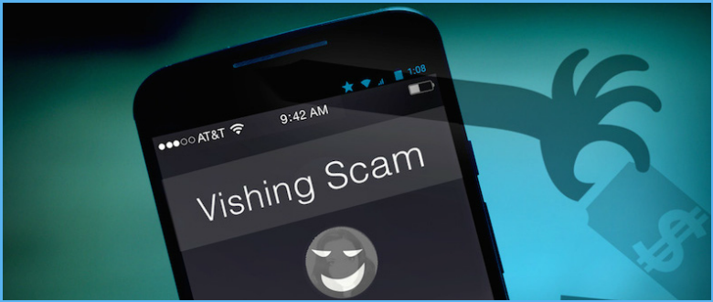
VISHING (VOICE PHISHING)
Vishing is the telephone equivalent of phishing. It is described as the act of using the telephone in an attempt to scam the user into surrendering private information that will be used for identity theft.
Vishing scams include things like:
Unsolicited offers for credit and loans
Exaggerated investment opportunities
Charitable requests for urgent causes
Extended car warranty scams

Slide 11
VISHING PREVENTION
The simplest advice for staying safe on the phone is, “When in doubt, hang up.”
Think before you speak. Scammers want you to act — and give out information — before you think things through. The person on the end of the line may sound sincere and trustworthy, but that doesn’t mean they’re legitimate.
Be particularly concentrate of scare tactics, prizes and special offers.
Be aware that caller ID can be easily spoofed by scammers.
Verify phone numbers before calling back. If you’re given a toll-free number to call, look up the correct number yourself, either online or using the back of your credit card.
Use a different phone to call back.

Slide 12
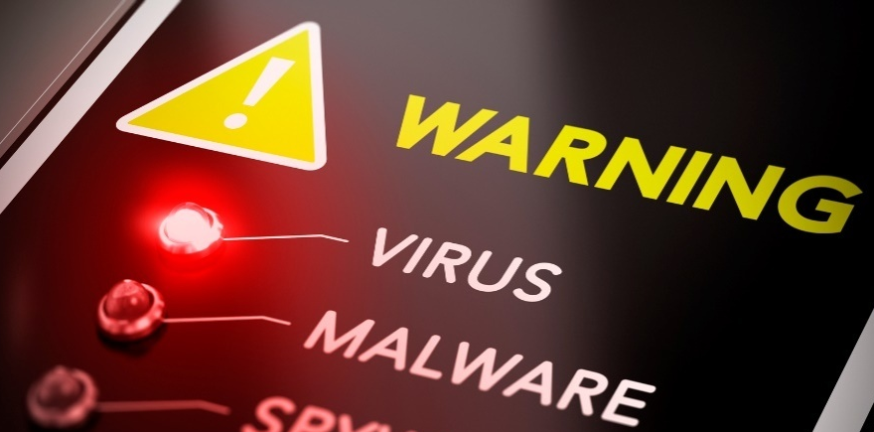
VIRUS/ MALWARES
Malware (malicious software) is any software intentionally designed to cause damage to a computer, server, client, or computer network. A wide variety of types of malware exist including computer viruses, worms, Trojan horses, ransomware, spyware, adware etc

Slide 13
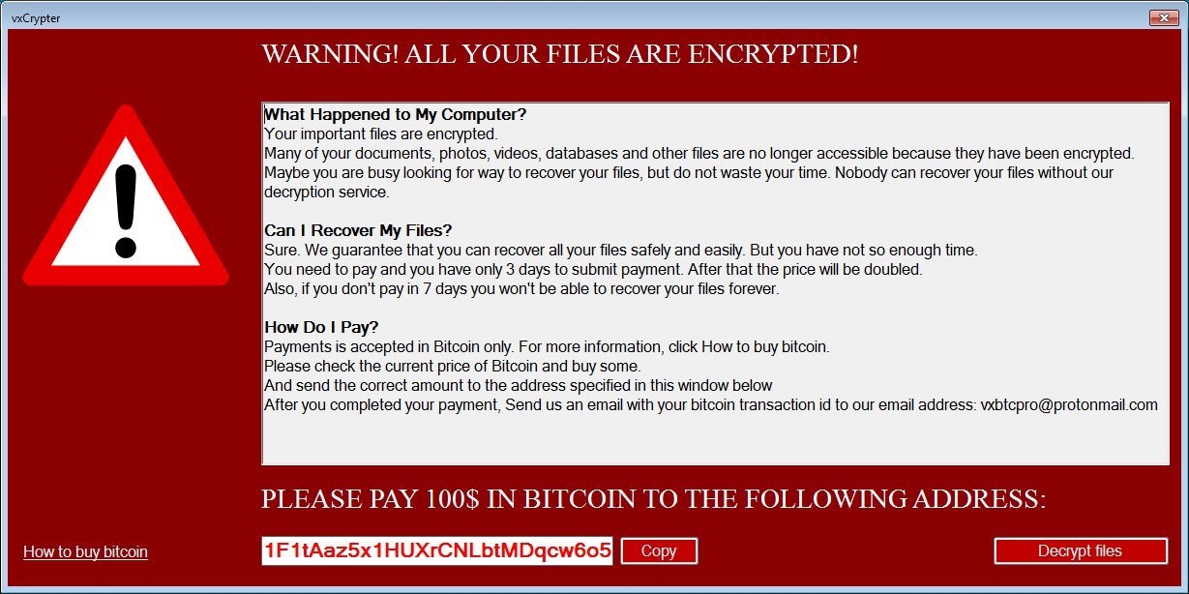
RANSOMWARE
Type of malware that prevents users from accessing their system or personal files and the attacker demands ransom payment in order to regain access to data.

Slide 14
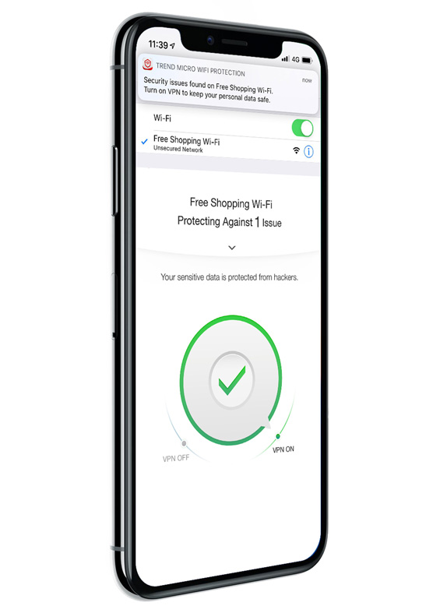
PROTECTING MOBILE DEVICES
Use strong passwords/biometrics
Ensure avoid public or free Wi-Fi
Encrypt your device
Install an antivirus application
Always have a backup
Update to the latest software
Use apps from trusted sources
Don’t use shared apps

Slide 15
ANTI-VIRUS
Anti-virus software detects malware and can quarantine or delete it before any damage is done
Install and maintain anti-virus software
Be sure to keep anti-virus software updated

Slide 16
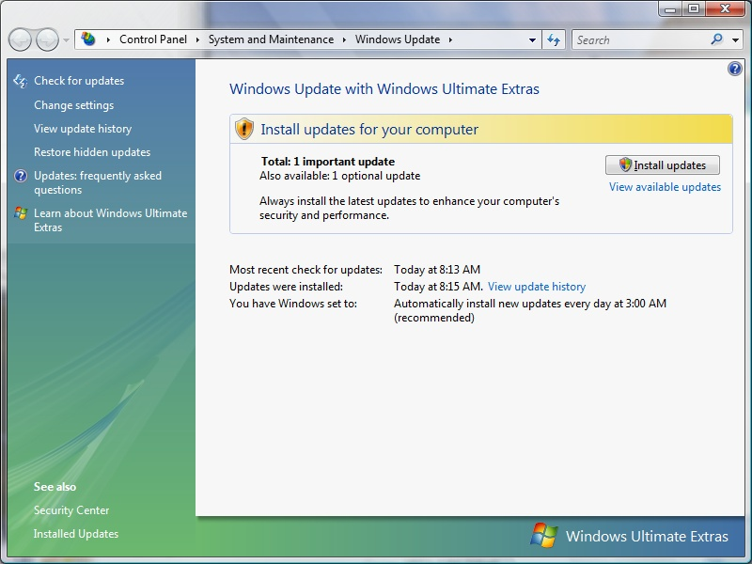
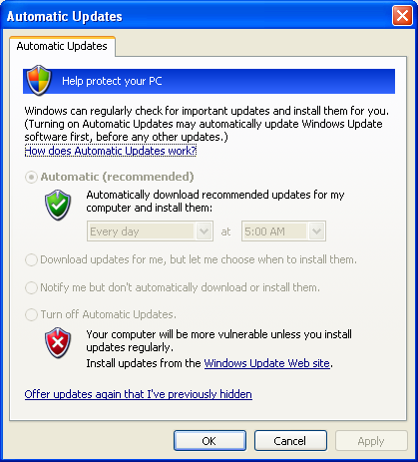
PROTECTING YOUR OPERATING SYSTEM
Always use Licensed/Genuine Windows
Update the operating system to latest security patches on regular basis.
The Windows Update feature should be set up to automatically download and install updates.

Slide 17
CREATING A GOOD PASSWORD
Contain at least three of the five following characte classes:
Lower case characters
Upper case characters
Numbers
Punctuation
“Special” characters (e.g. @#$%^&*()_+|~-=\`{}[]:";'<>/ etc)
Contain at least 8 alphanumeric characters.

Slide 18
E-MAILS
Official e-mail system should be used only for official e-mails
Do not download mail attachments which are received from unknown sources
Do not follow a web-link received in a mail message from unknown sources.
Report to the System Administrator about receipt of Spam mails
Never share confidential information through mail message unless the contents are encrypted.

Slide 19
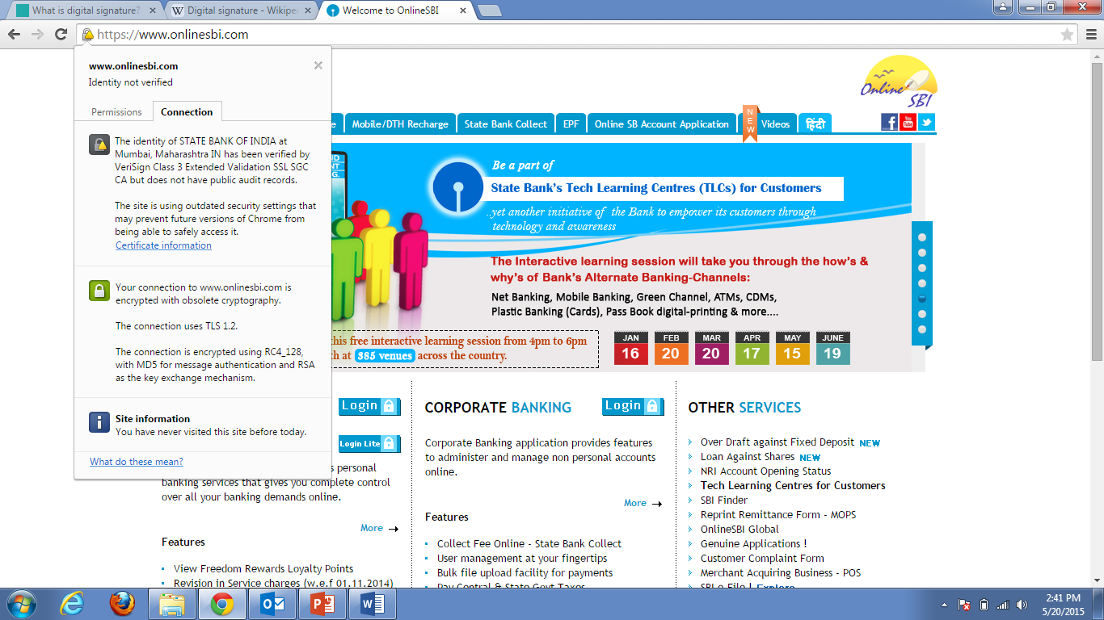
SECURE ONLINE BANKING
Always use secure browser to do online activities.
Avoid clicking through emails.
Always log out when you are done
Monitor your accounts regularly
Keep a habit of changing password regularly
https://

Slide 20
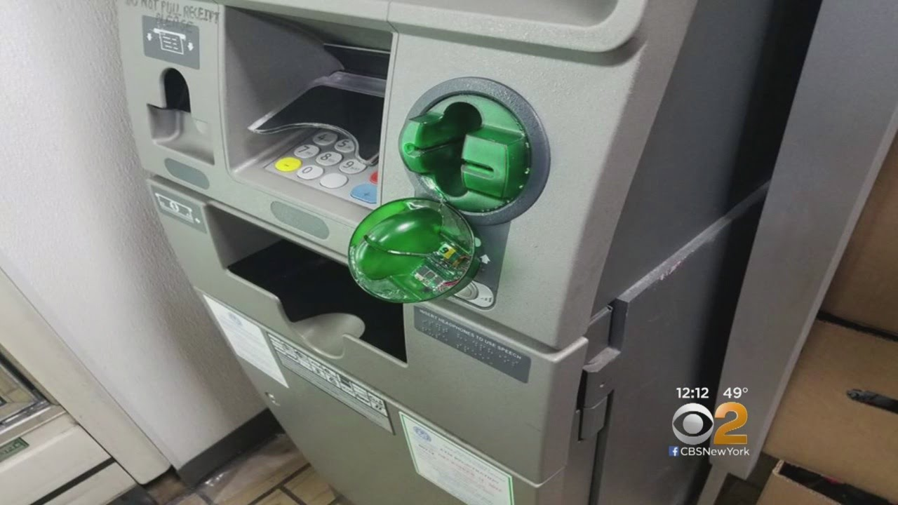
ATM SKIMMING
Fraudsters can attach false casings and PIN pad overlay devices onto genuine existing ATMs, or they can attach a camouflaged skimming device onto a card reader entry used in tandem with a concealed camera to capture and record PIN entry details.

Slide 21
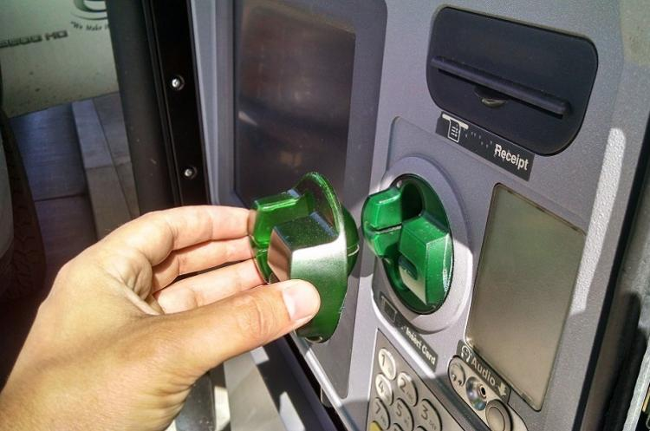
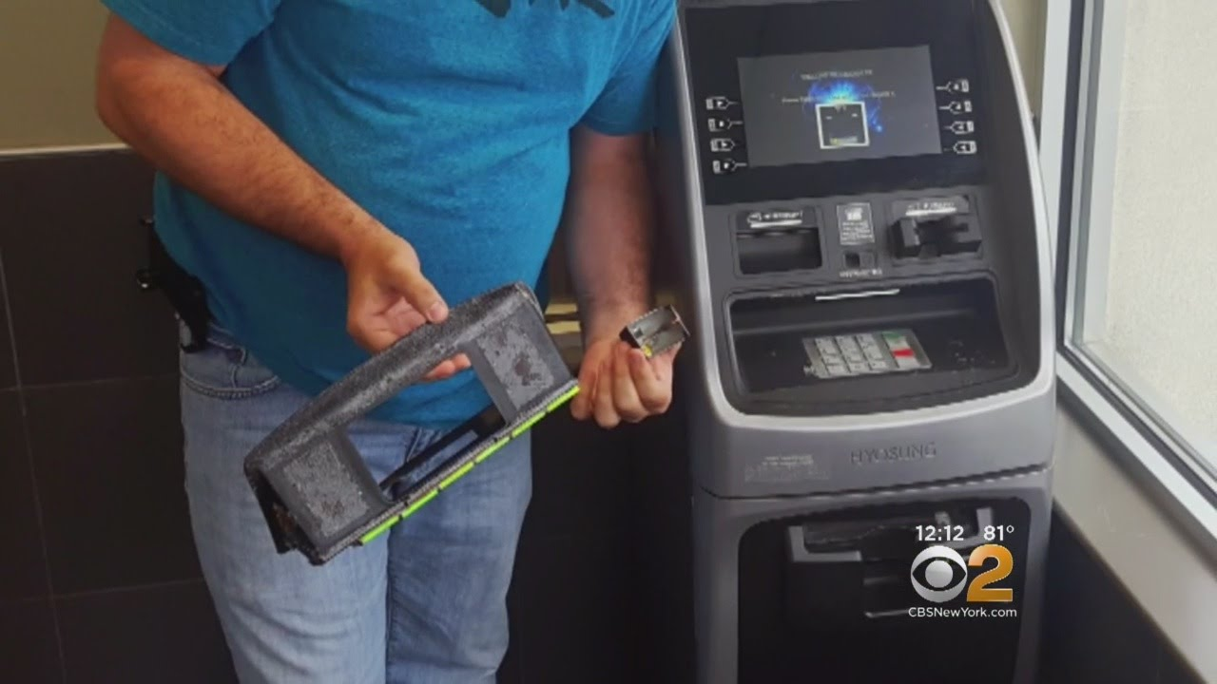
ATM SKIMMING

Slide 22
PREVENTION BANKING FRAUDS
Avoid saving Credit card / Debit card information in Online Wallets.
Don’t link your UPI to Paytm Wallet means install Paytm on such phones which is not linked to any Bank Account.
Use 3-D secure Pin for every transaction of Credit/Debit Card.
Set daily transaction limit in your Credit or Debit Cards & use Virtual cards for online transactions.
Check the transactions messages carefully that requires user input.
Avoid clicking links received in emails or SMS. Don’t click on untrusted SMS link and delete such messages.

Slide 23
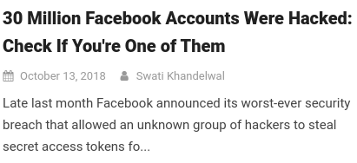
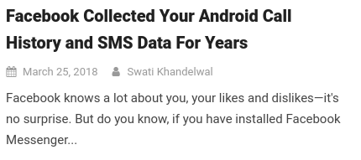

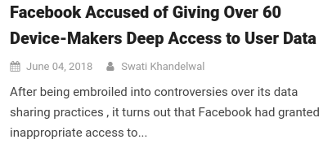
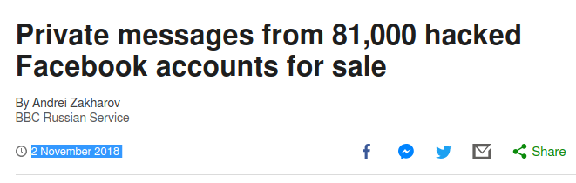

SOCIAL MEDIA THREATS

Slide 24
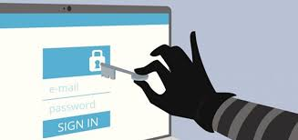
SOCIAL MEDIA THREATS
Identity theft or data leakage
Fake requests from spam profiles
Profile hacking
Fake apps and malicious links

Slide 25
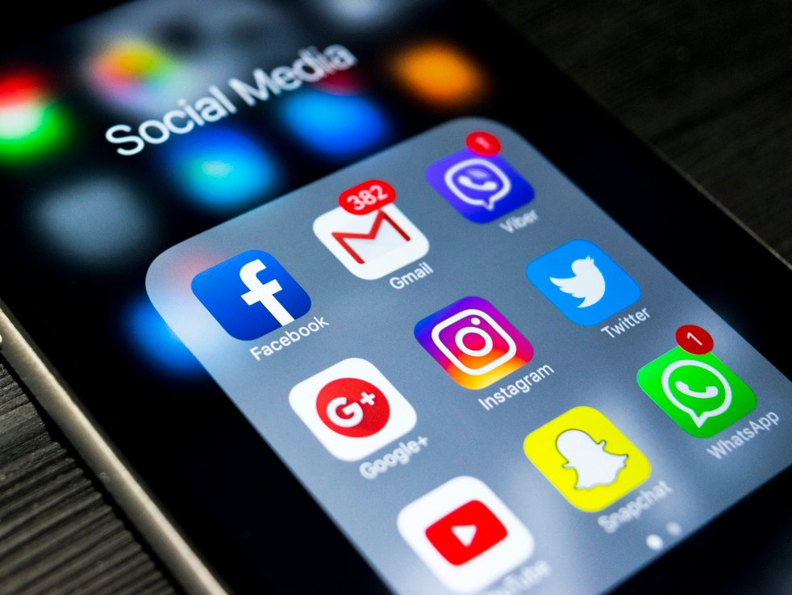
SOCIAL MEDIA PREVENTIVE MEASURES
Strong password
Watch your mailbox
Avoid auto likers
Using two-factor authentication
Proper privacy setting of your social profiles
Don’t accept requests from unknown profiles
Think twice before clicking any links
Identify fake apps before installation
Think before you share
Turn off GPS for photographs

Slide 26
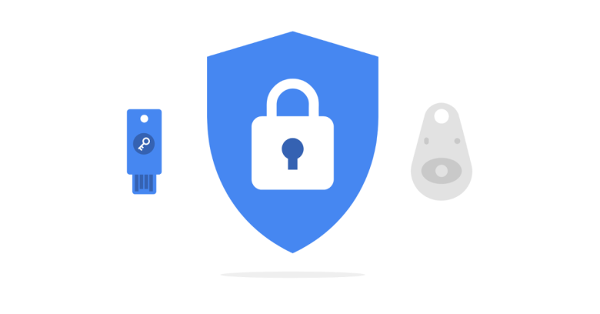
GENERAL SECURITY BEST PRACTICES
Install anti-virus software and keep all computer software patched. Update operating systems, applications and antivirus software regularly.
Encrypt Sensitive Data & Backup your data regularly
Never share your Personal Info like Aadhaar card. PAN Card, Passport etc. details with strangers.
Use two-factor authentication 2FA

Slide 27
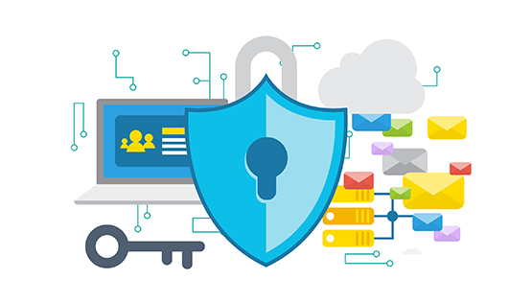
GENERAL SECURITY BEST PRACTICES
Prefer passphrase instead of passwords
Keep your passwords private
Be wise & vigilant about using public Wi-Fi
Disable automatic uploading
Never share important documents in public groups

